Slide 1
WAVES 2022
Highly Accurate Absorbing Boundary Conditions for Acoustic Waves
Collaborators:
Tahsin Khajah
Department of Mechanical Engineering, University of Texas at Tyler
Jonathan Hale Graduate Student Department of Mathematics, Brigham Young University
Monu Jaiswal Graduate Student Department of Mechanical Engineering, University of Texas at Tyler
Other Collaborators:
David Modesto
Barcelona Supercomputer Center
Spain
Sebastian Acosta Baylor College of Medicine Texas Children's Hospital
Dane Grundvig
Graduate Student
Rice University, Houston,Texas
Jacob Badger Graduate Student Oden Institute for Computational Engineering and Sciences University of Texas at Austin
Otilio Rojas
Barcelona Supercomputer Center
Spain
Dr. Vianey Villamizar
Notes:
1

Slide 2
Outline
MODELING PART:
  Derivation of Local High Order Absorbing Boundary Condition (ABC) for Single Acoustic Scattering
NUMERICAL PART:
  Construction of a Numerical Method
  Discrete Problem. Algebraic Linear System
NUMERICAL APPROXIMATIONS.
  Numerical Experiments
  Accuracy and Convergence Analysis

Slide 3
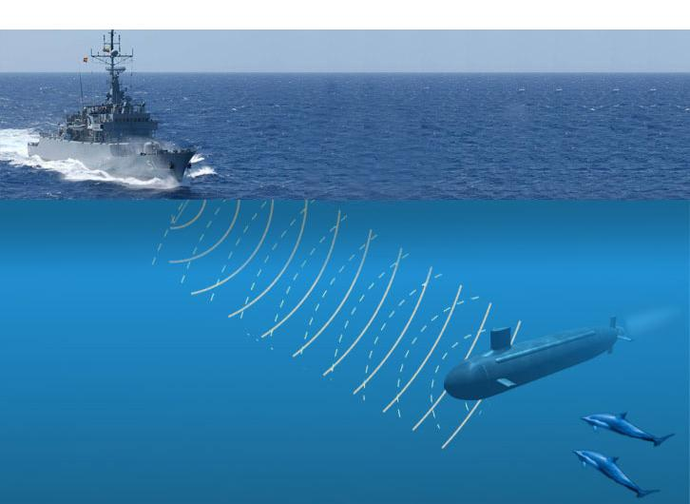
Description of Physical Problem
Notes:
The derivation and applications of these ABC are fundamental in the study of scattering problems in the Ocean, air and gin the ground

Slide 4
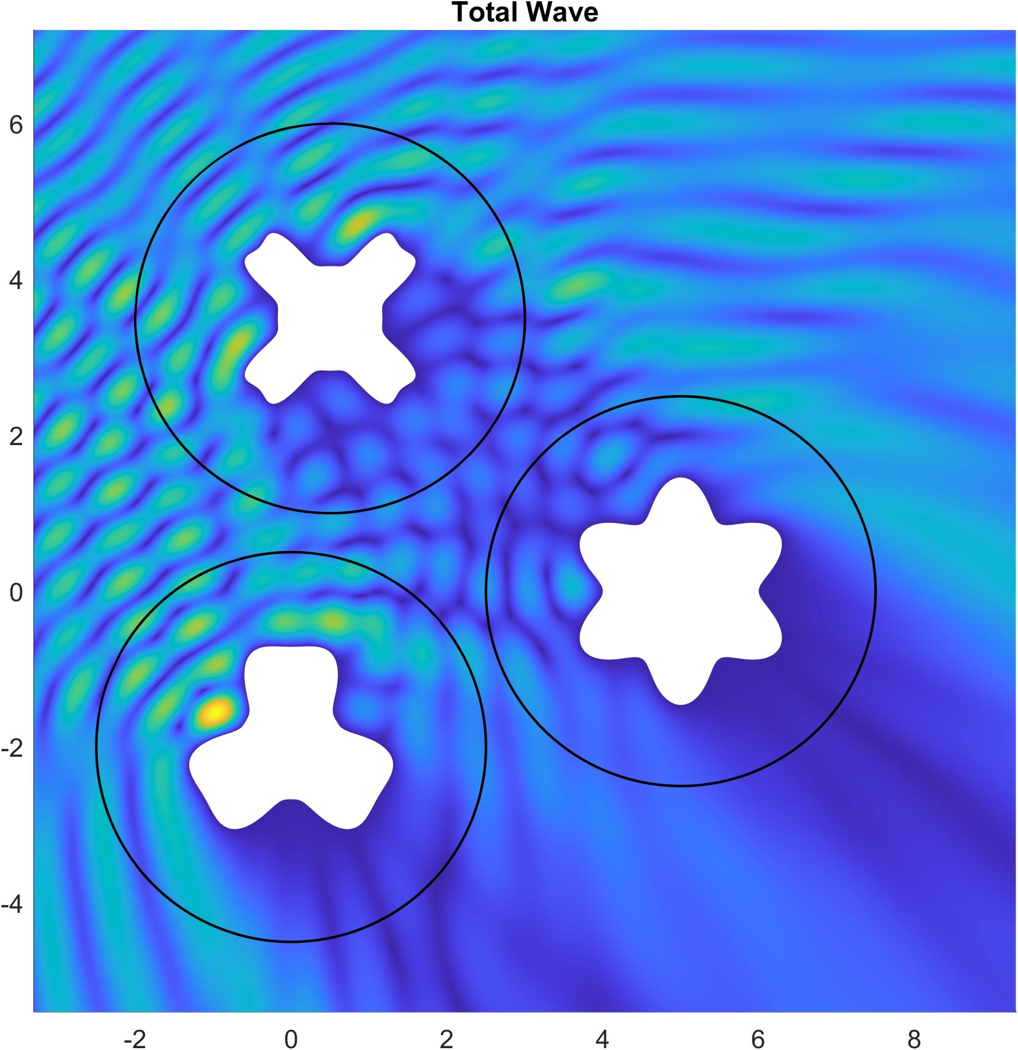


Description of Physical Problem
$$λ=\frac{2π}{k}$$
$$φ$$

Slide 5
Description of Physical Problem
Acoustic Single Scattering (2D)
Notes:
To illustrate the derivation, I consider an incident wave which is propagating in a direction perpendicular to the axis of an infinite circular cylinder.

Slide 6
Mathematical Model
Single Acoustic Scattering
Time-Harmonic

Slide 7
Truncation of the Domain.
Introducing an Artificial Boundary
Notes:
To illustrate the derivation, I consider an incident wave which is propagating in a direction perpendicular to the axis of an infinite circular cylinder.

Slide 8
Description of Physical Problem
$$λ=\frac{2π}{k}$$
$$φ$$

Slide 9
Computational Challenge
Using Finite Elements and Finite Differences Methods
Imposing a mathematically efficient TRANSPARENT BOUNDARY CONDITION on the Artificial Boundary S with minimum spurious reflection.

Slide 10
Computational Goals
Derivation of an overall high order and highly accurate numerical method:
  High order numerical technique in the interior of the computational domain.
  Couple with a computationally efficient high order absorbing boundary condition (ABC) that does not drop the high order of the interior numerical method.
Computational domain relatively small. Low number of operations.
Relatively easy implementation.

Slide 11
Most Elementary
Absorbing Boundary Condition on S

Slide 12
Key Idea for Defining ABC (2D)
Karp Theorem
Comm. Pure Appl. Math. (1961)

Slide 13
Key Idea for Defining ABC (2D)
Karp Theorem
Comm. Pure Appl. Math. (1961)

Slide 14
Absorbing Boundary Conditions: Annihilating Operator in 2D

Slide 15
Absorbing Boundary Conditions: Annihilating Operators

Slide 16
Absorbing Boundary Conditions Based on Annihilating Operators
Absorbing boundary conditions on S

Slide 17
Mathematical Model 2
(bounded)

Slide 18
Absorbing Boundary Conditions: Annihilating Operators

Slide 19
Types of Absorbing boundary Condition
Until 1970s Sommerfeld-like ABC dominated.
From late 1970s to mid 1980s. Low order ABC appeared Bayliss-Turkel (SIAM Appl. Math 1982), Engquist-Majda (Comm. Pure Appl. Math 1979), Higdon (Math Comput. 1987), Kriegsmann et al. (IEEE Trans. Ant. Prop. OSRC 1987)
In the late 1980s and mid-1990s exact non-local ABC appeared like those based on Dirichlet to Neumann map: Givoli (JCP 1992), Grote (SIAM 1995), more recent Acosta-Villamizar (JCP 2010)
Mid 1990s perfectly matched layer (PML) was invented. Berenger (JCP 1994)
Since the mid-1990s until now high order local ABC have been developed. This is our subject today.

Slide 20
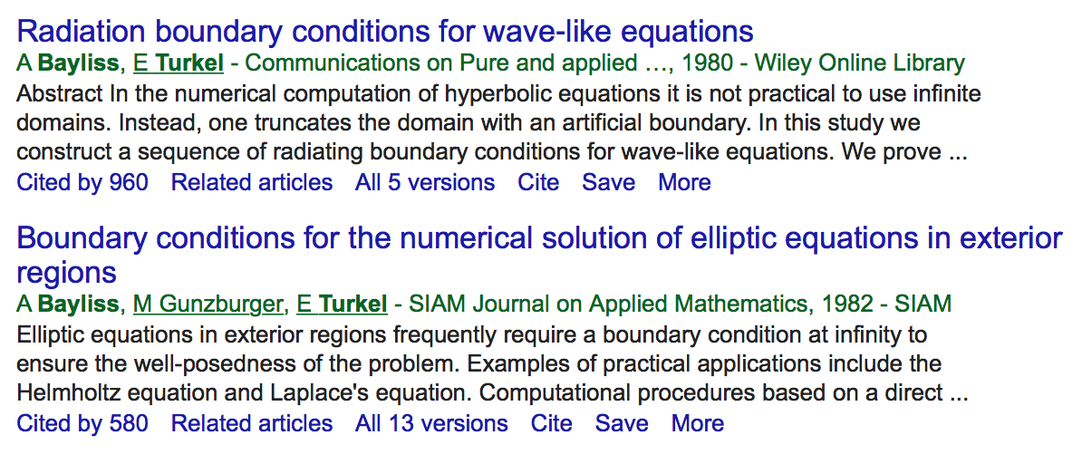
Importance of Absorbing boundary Condition

Slide 21
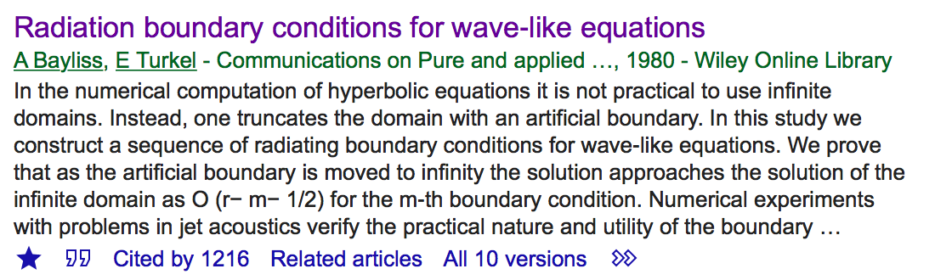
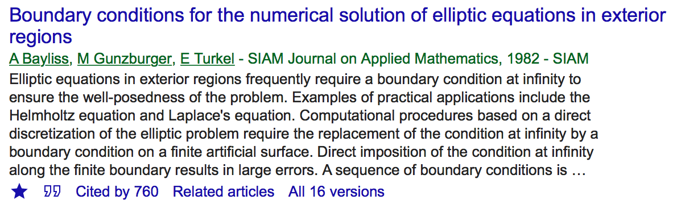
Importance of Absorbing boundary Condition 5 Years Later

Slide 22
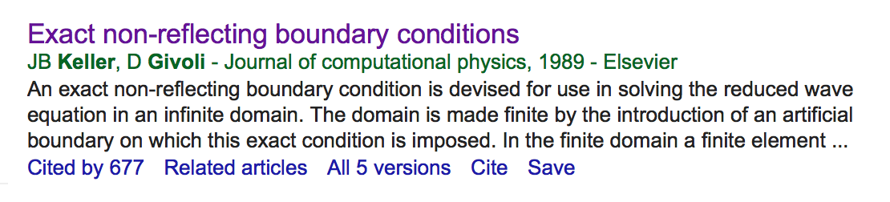
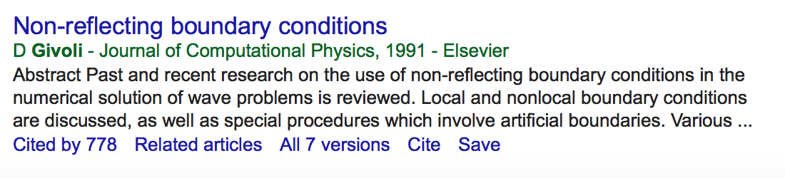
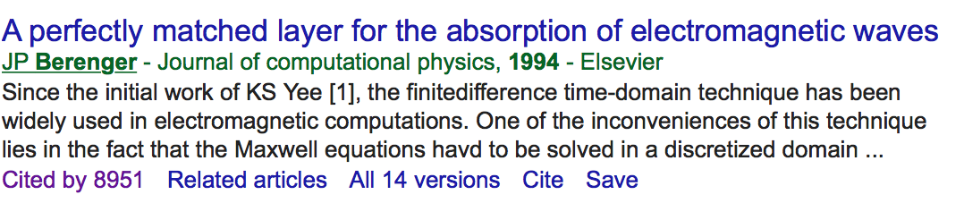
Importance of Absorbing boundary Condition

Slide 23
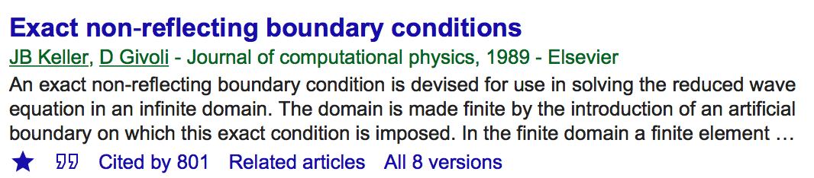
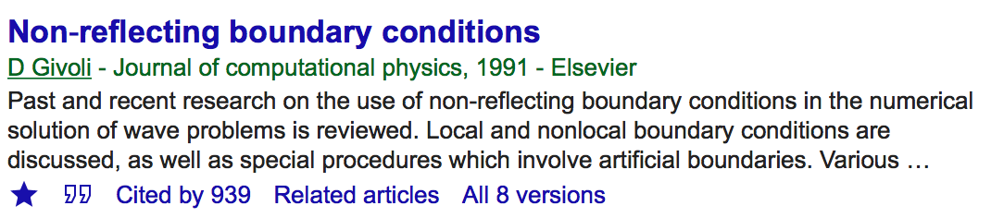
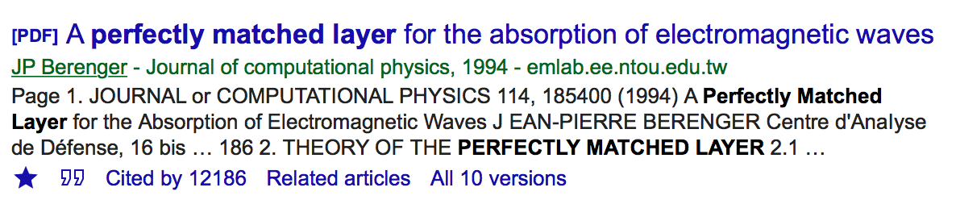
Importance of Absorbing boundary Condition 5 Years Later

Slide 24
Our Idea:
Derivation of Farfield Expansions ABC
How can we increase the order of the approximation at the artificial boundary without increasing the complexity of the ABC ?

Slide 25
Mathematical Model:
Interface Condition
S
S
S

Slide 26
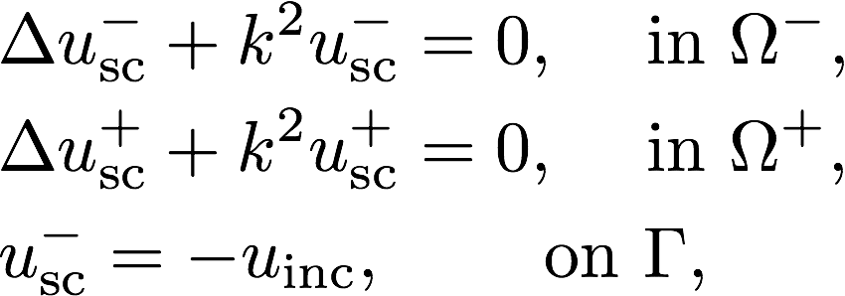
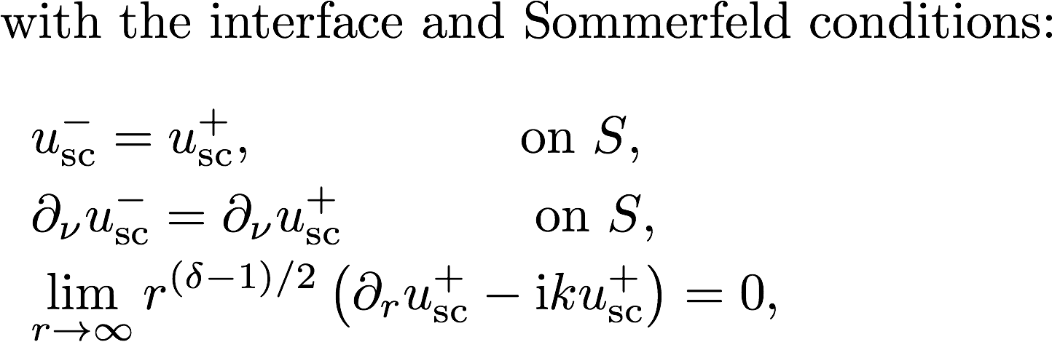
Equivalent Interface Problem
Acosta-Villamizar (JCP 2010)

Slide 27
Equivalent Interface Problem
The equivalence between the interface problem and the original exterior problem means that their solutions are the same.
We proved the well-posedness of the interface problem for a smooth artifical boundary in
Acosta-Villamizar: J. Comp. Physics (2010)

Slide 28
Absorbing Boundary Conditions
Based on Farfield Expansions
KEY IDEA:
WHY NOT USE WILCOX (3D), KARP (2D), or KARP Asymptotic (2D) DIRECTLY to define absorbing boundary condition (ABC) at S ?
Advantage is that there are not higher order derivatives involve in the ABC
By simply adding new terms to the farfield expansions is possible to increase the order of accuracy of the ABC to a desired precision.

Slide 29
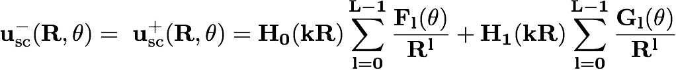
Derivation New Bounded 2D Problem
w/o High Order Derivatives in the ABC
S
Notes:
How do we use Wilcox’s theorem?

Slide 30
Derivation New Bounded 2D Problem

Slide 31
Complete New Bounded 2D Problem
Villamizar-Acosta-Dastrup (JCP 2017)

Slide 33
Numerical Experiments
Convergence KDFE_L vs KSFE_L

Slide 34
Asymptotic Expansion of Karp’s Series

Slide 35
Far-Field Pattern 2D (FFP)

Slide 36
Numerical Experiments
Analysis of Convergence

Slide 37
Numerical Experiments
Convergence Various ABCs

Slide 38
Numerical Experiments
Order of Convergence Various ABCs

Slide 39
Numerical Experiments
Scattering from Complexly shaped Obstacles

Slide 40
Numerical Experiments
Order of Convergence Complex Obstacles

Slide 41
Numerical Experiments
Scattering from a Spherical Scatterer (3D)

Slide 42
Numerical Experiments
Analysis of Convergence FFP

Slide 44
Future Work Back in
2016-2017
Coupling of HOM with the Farfield Expansions ABC. Overall High Order Method
Multiple Scattering with Farfield Expansions ABCs.
Derivation and Implementation of Farfield Expansions in Elastodynamic Scattering Problems

Slide 45
Work Accomplished
2017-2023
-- Overall High Order and Highly accurate Numerical Method for Single Scattering based on an Isogeometric Finite Element Method:
T. Khajah and V. Villamizar. Highly accurate acoustic scattering: Isogeometric analysis coupled with local high order farfield expansion ABC. Comput. Methods Appl. Mech. Engrg., 349:477–498, 2019
V. Villamizar, D. Grundvig (Master Thesis), O. Rojas, and S. Acosta. High order methods for acoustic scattering: Coupling Farfield Expansions ABC with Deferred-Correction methods. Wave Motion, 95:(24 pages), 2020
-- Derivation of High Order Farfield Expansion ABC for Acoustic Multiple Scattering:
V. Villamizar, J. Badger, and S. Acosta. High order local farfield expansions absorbing boundary conditions for multiple scattering. J. Comput. Phys., 460:(32 pages), 2022

Slide 46
Work Accomplished
2017-2023
--- Highly Efficient Iterative Numerical Method for Acoustic Multiple Scattering:
T. Khajah, V. Villamizar, and J. Hale (Master Thesis). Iterative methods for multiple scattering. In its final writing stage.
--- Derivation of 2D and 3D High Order Local Farfield Expansions ABCs for Elastic Scattering:
V. Villamizar, D. Grundvig (Master Thesis), and O. Rojas. High order local ABC for elastic scattering in terms of farfield expansions.
--- Derivation of High Order Local Farfield Expansiosn ABCs for time-dependent scattering (Wave Equation):
V. Villamizar, M. Quezada and D. Ketcheson. A time-dependent high order local absorbing boundary conditions for acoustic waves. In final writing stage.

Slide 47
Future work
Construction of an Overall High order Method for Multiple Scattering in Elastodynamic.
Derivation of High Order Local Farfield Expansions ABCs using more general shapes for Artificial Boundaries.
Extension to Electromagnetic Waves.

